Slide 1
Maximum likelihood estimation 27 enero 2025

Slide 2
How do we estimate things?
Specify a model
Function generating predictions
Identify plausible values for any unknown parameters
Maximize probability of observations given function
Assess uncertainty
Explore function around plausible values

Slide 3
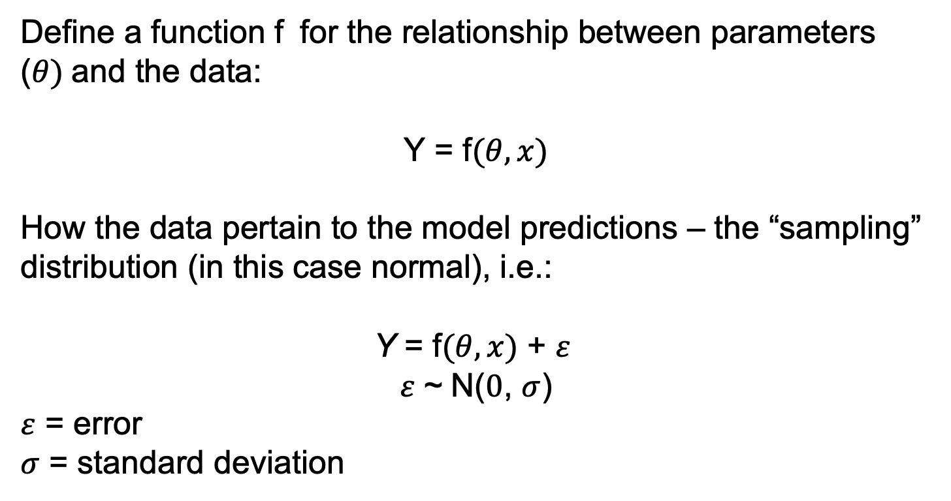
Start with a model
Define a function f for the relationship between parameters ($θ)$and the data:
Y = f$(θ,x)$
How the data pertain to the model predictions – the “sampling” distribution (in this case normal), i.e.:
Y = f$(θ,x)$ + $ε$
$ε$~ N($0$, $σ$)
$ε$ = error
$σ$ = standard deviation

Slide 4

Ex. estimate the mean and variance
f$(θ)$ = $μ$
Can be written multiple ways:
Y ~ N($μ$, $σ$)
Y = $μ$ + $ε$ where $ε$~ N($0$, $σ$)
$Y_{i}$ = $μ$ + $ε_{i}$ where $ε_{i}$~ N($0$, $σ$)
$μ$ = mean
$σ$ = standard deviation
$i$ = $observation$

Slide 5
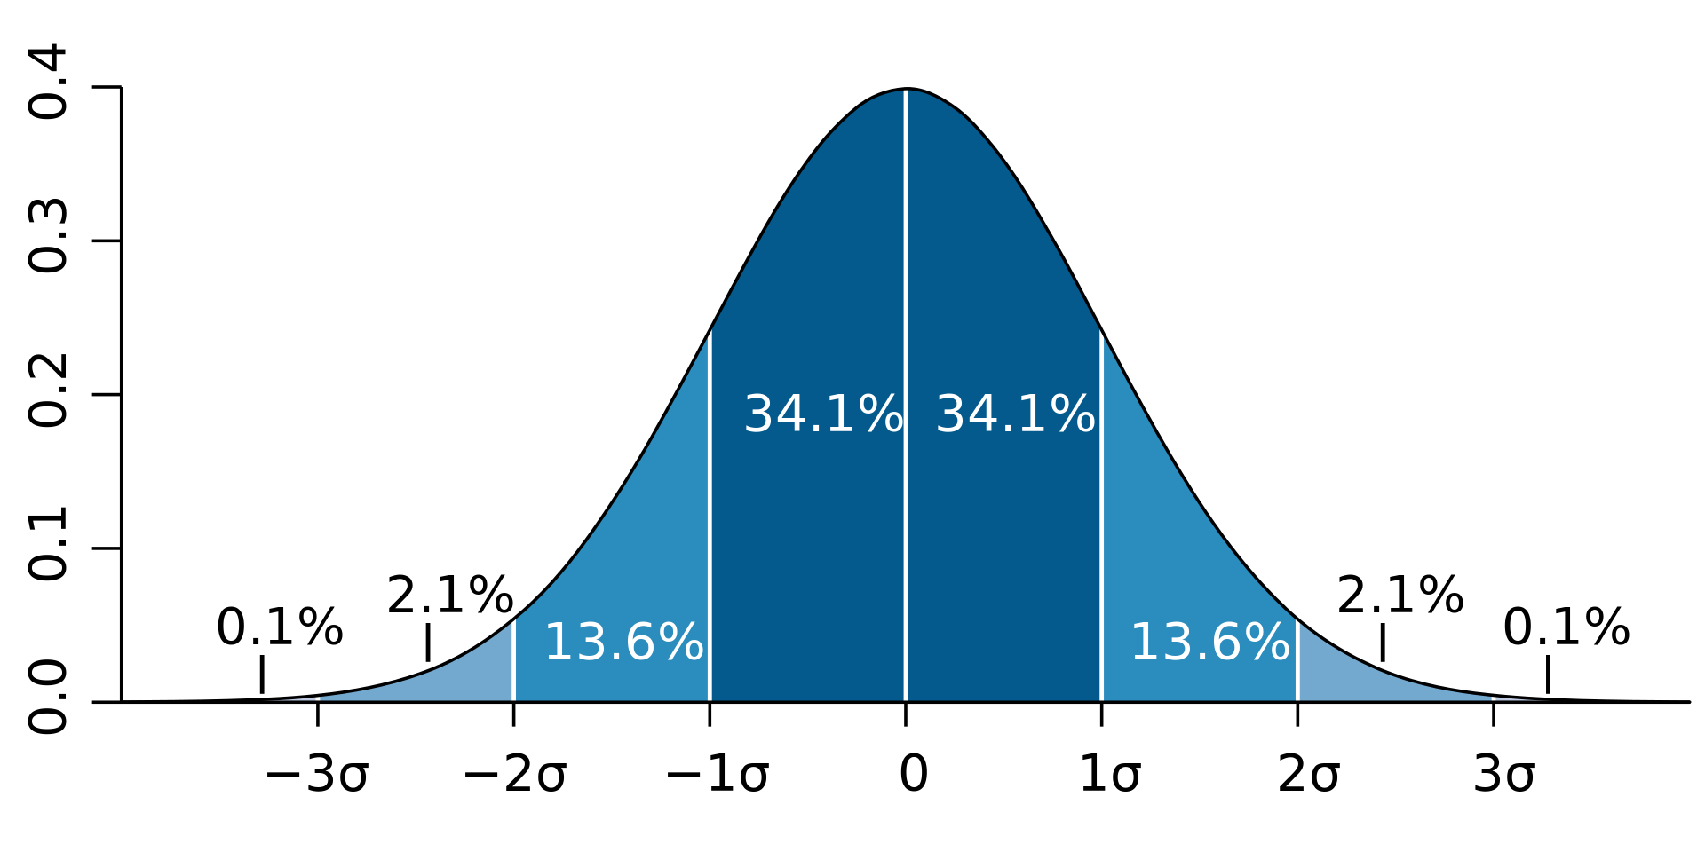

Estimate the mean
$$μ$$

Slide 6
Common distributions

Slide 7
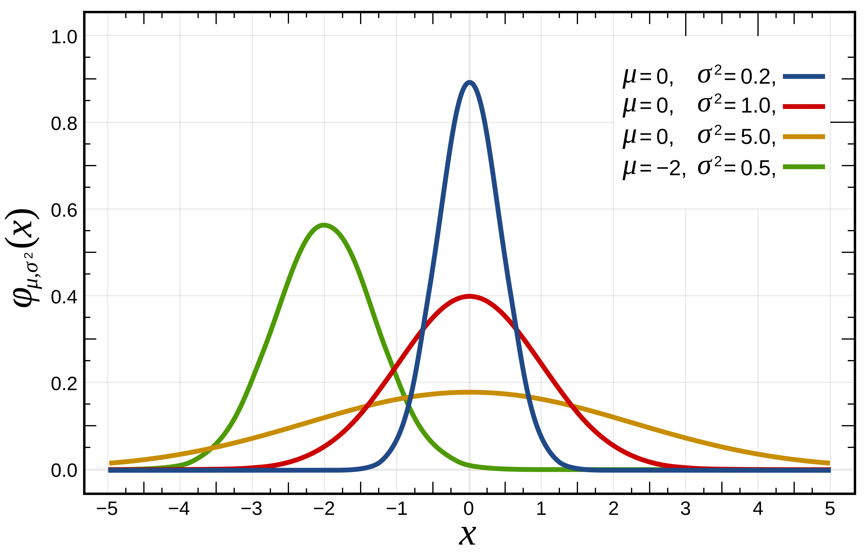
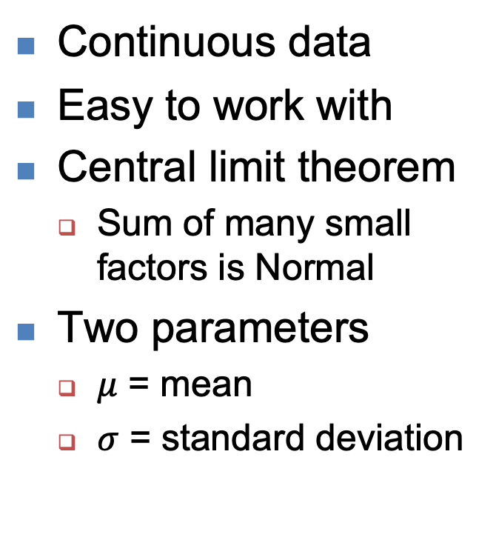
Normal
Continuous data
Easy to work with
Central limit theorem
Sum of many small factors is Normal
Two parameters
$μ$ = mean
$σ$ = standard deviation

Slide 8
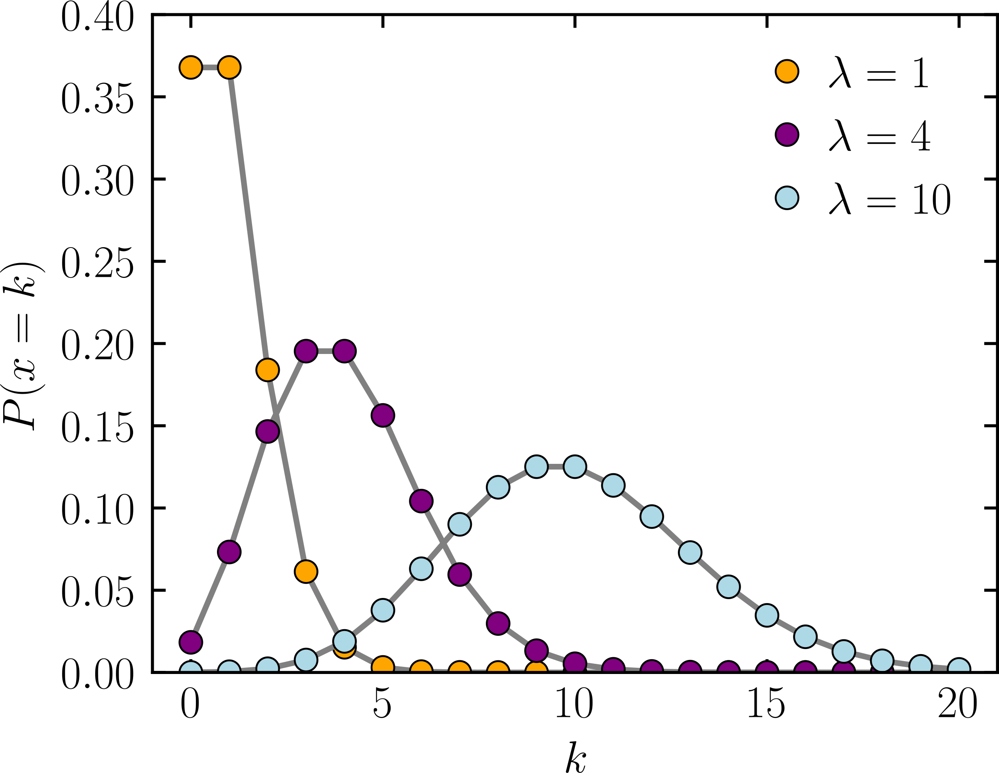
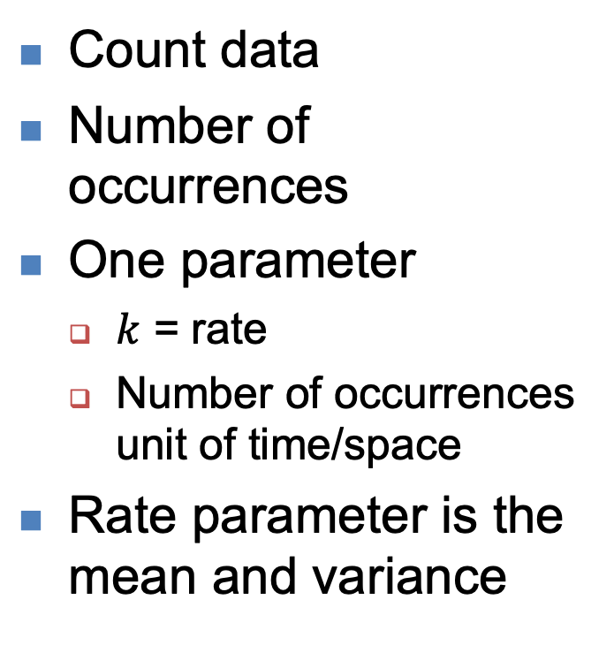
Poisson
Count data
Number of occurrences
One parameter
$k$ = rate
Number of occurrences unit of time/space
Rate parameter is the mean and variance

Slide 9
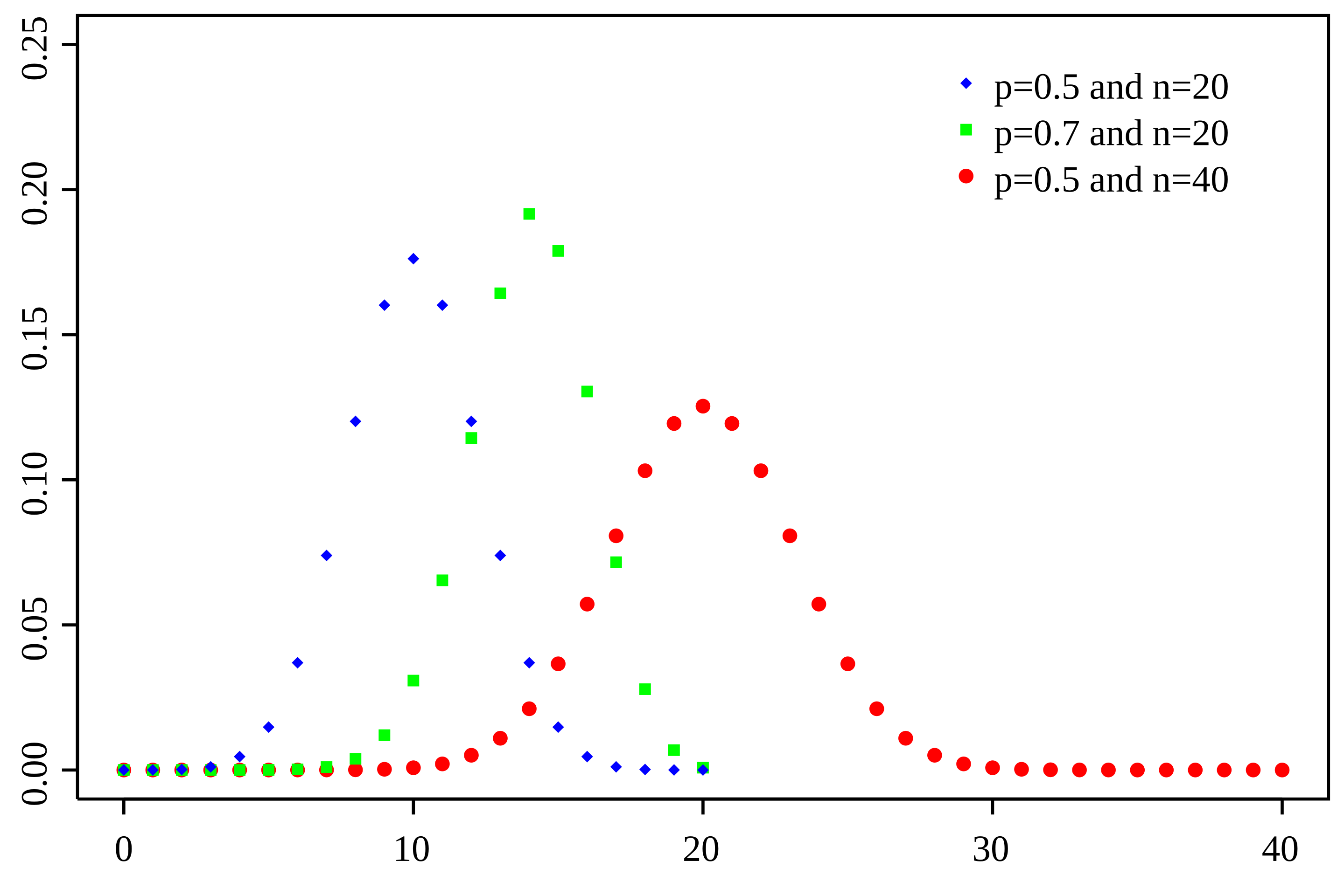
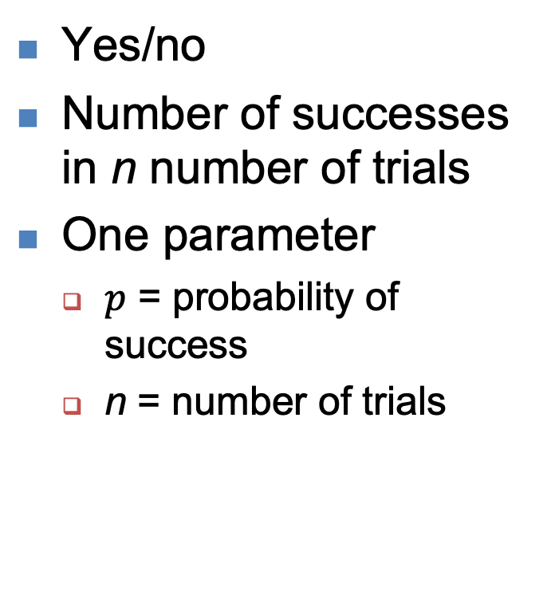
Binomial
Yes/no
Number of successes in n number of trials
One parameter
$p$ = probability of success
n = number of trials

Slide 10
Parameter estimation

Slide 11
Maximum likelihood
Given a set of data (D) we define a probability model with parameters (p) we want to estimate
Prob(D|p)

Slide 12
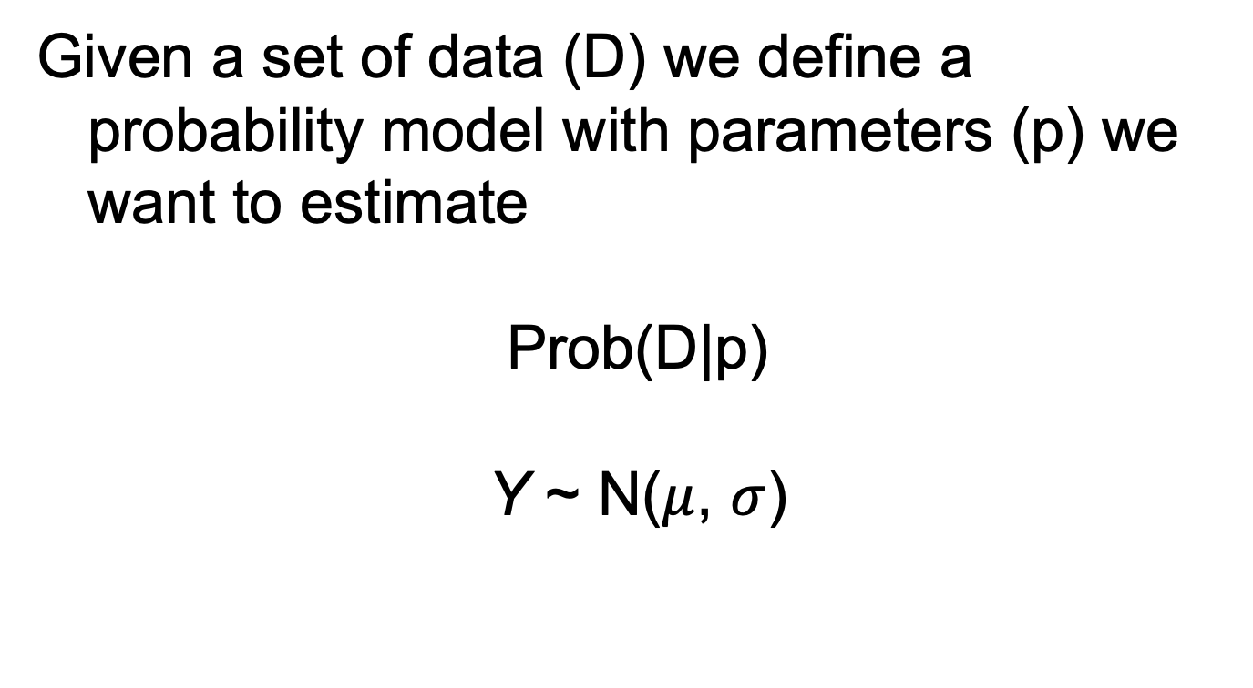
Maximum likelihood
Given a set of data (D) we define a probability model with parameters (p) we want to estimate
Prob(D|p)
Y ~ N($μ$, $σ$)

Slide 13
Maximum likelihood
Given a set of data, and a probability model, maximum
likelihood chooses the values for the parameters that make
the data “most likely”.
The likelihood of the data D given the parameter(s) p is the
probability of the data given the parameter(s).
Note:
Probability: knowing parameters -> predicting data.
Likelihood: knowing data -> parameter estimation.

Slide 14


Probabilitidades vs verosimilitudes
La diferencia puede ser confusa
$$N(μ=?,σ=?)$$
$$N(μ=2,σ=1)$$
Modelo
Verosimilitud
Probabilidad
Datos
$$x=\{2.1,3.9,−1.2\}$$
$$x=\{??\}$$

Slide 15
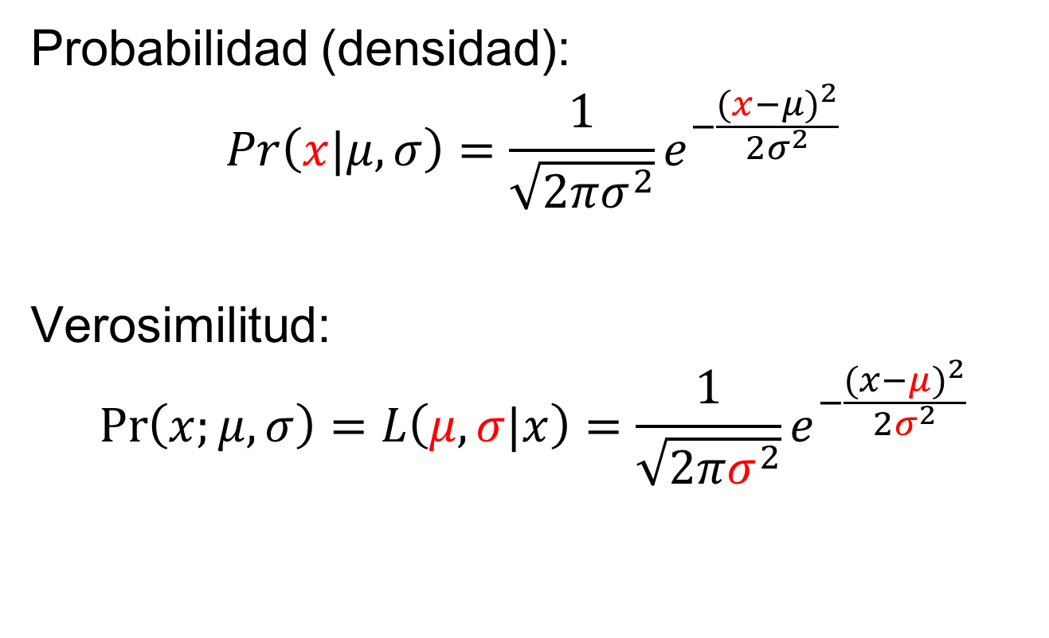
Verosimilitud normal
Probabilidad (densidad):
$$Pr\left(x|μ,σ\right)=\frac{1}{\sqrt{2πσ^{2}}}e^{−\frac{{(x−μ)}^{2}}{2σ^{2}}}$$
Verosimilitud:
$$\operatorname{Pr}\left(x;μ,σ\right)=L\left(μ,σ|x\right)=\frac{1}{\sqrt{2πσ^{2}}}e^{−\frac{{(x−μ)}^{2}}{2σ^{2}}}$$
Pero se calculan de la misma forma en R!
dnorm(x=2, mean=3, sd=1)

Slide 16
Basics of Likelihood
If the data consists of two parts D₁ and D₂, the likelihood
of the data D=D₁+D₂ is the product of the likelihoods
of each of D₁ and D₂:
Data point 1
Data point 2

Slide 17
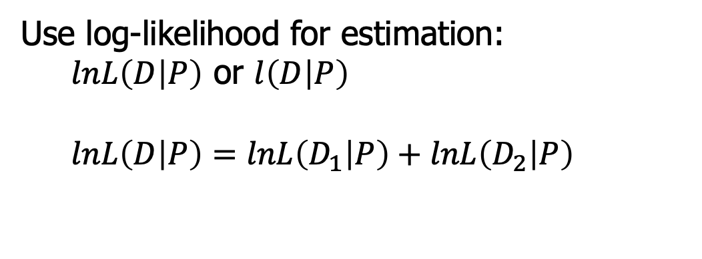
Basics of Likelihood
Use log-likelihood for estimation:
$lnL\left(D | P\right)$ or $l\left(D | P\right)$
$lnL\left(D | P\right)=lnL\left(D_{1} | P\right)+lnL\left(D_{2} | P\right)$

Slide 18
Maximum Likelihood
Given a likelihood function, we find the maximum likelihood
estimates for the parameters of the model, by maximizing the
log-likelihood, or minimizing the negative log-likelihood, i.e.:

Slide 19
Maximum Likelihood
Can solve this analytically (by hand) or
numerically (using computers and algorithms)

Slide 20
Analytical optimization
Binomial distribution
Probability of capture
20 hauls, 8 hauls with a shark

Slide 21
Analytical optimization
Probability of catching a shark
20 hauls, 8 hauls with a shark
Haul | Shark?
1 | 0
2 | 0
3 | 1
… | …
20 | 1

Slide 22
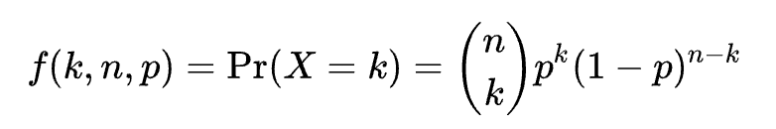
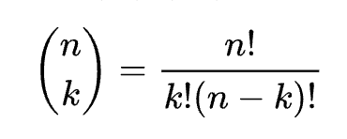
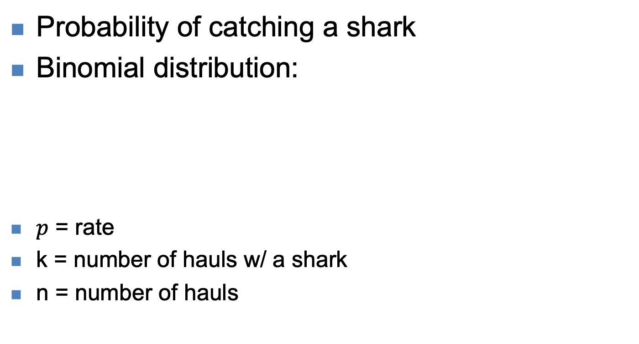
Analytical optimization
Probability of catching a shark
Binomial distribution:
$p$ = rate
k = number of hauls w/ a shark
n = number of hauls

Slide 23
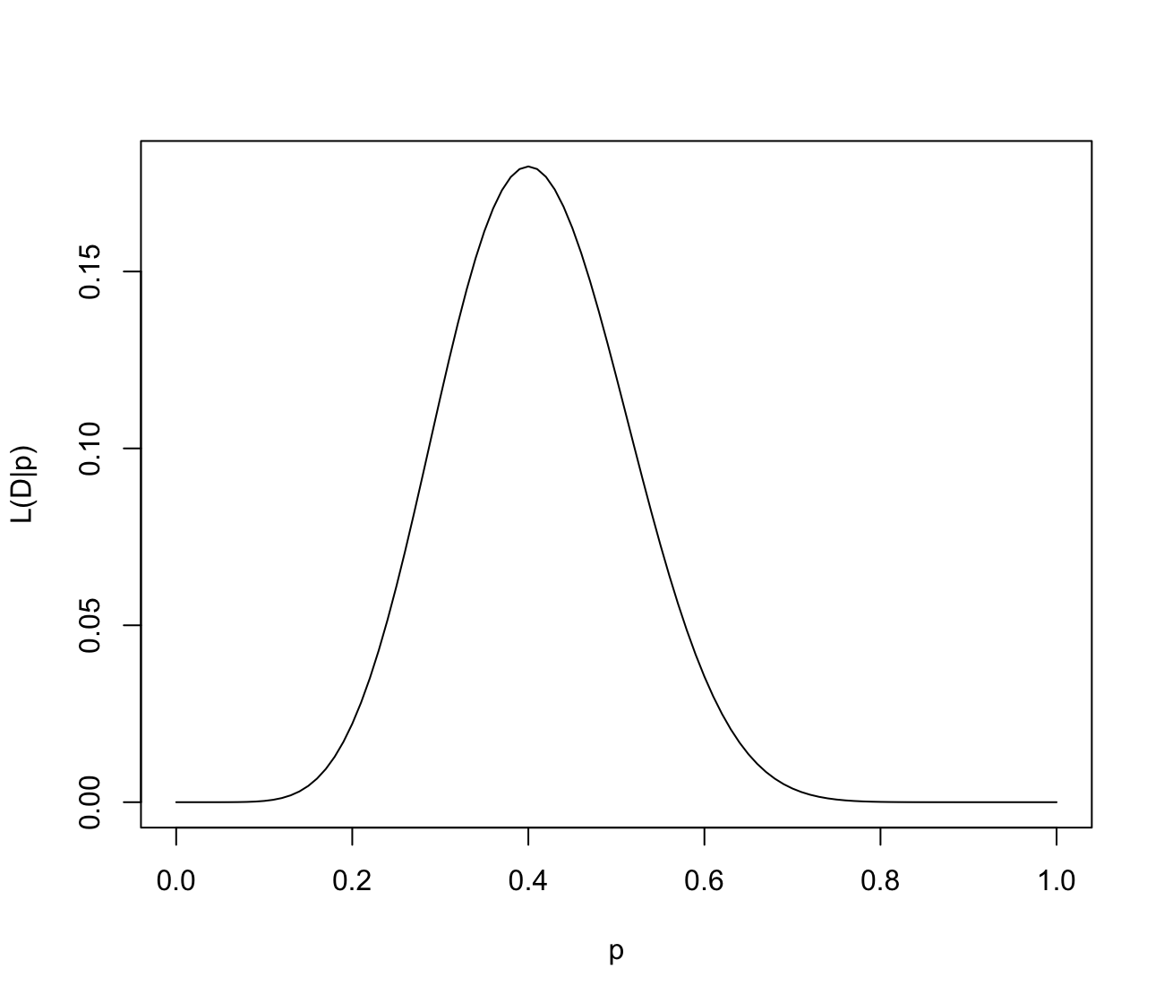

Analytical optimization
$$L\left(D | p\right)=\left(\begin{matrix}n \\ k\end{matrix}\right)p^{k}{\left(1−p\right)}^{n−k}$$

Slide 24
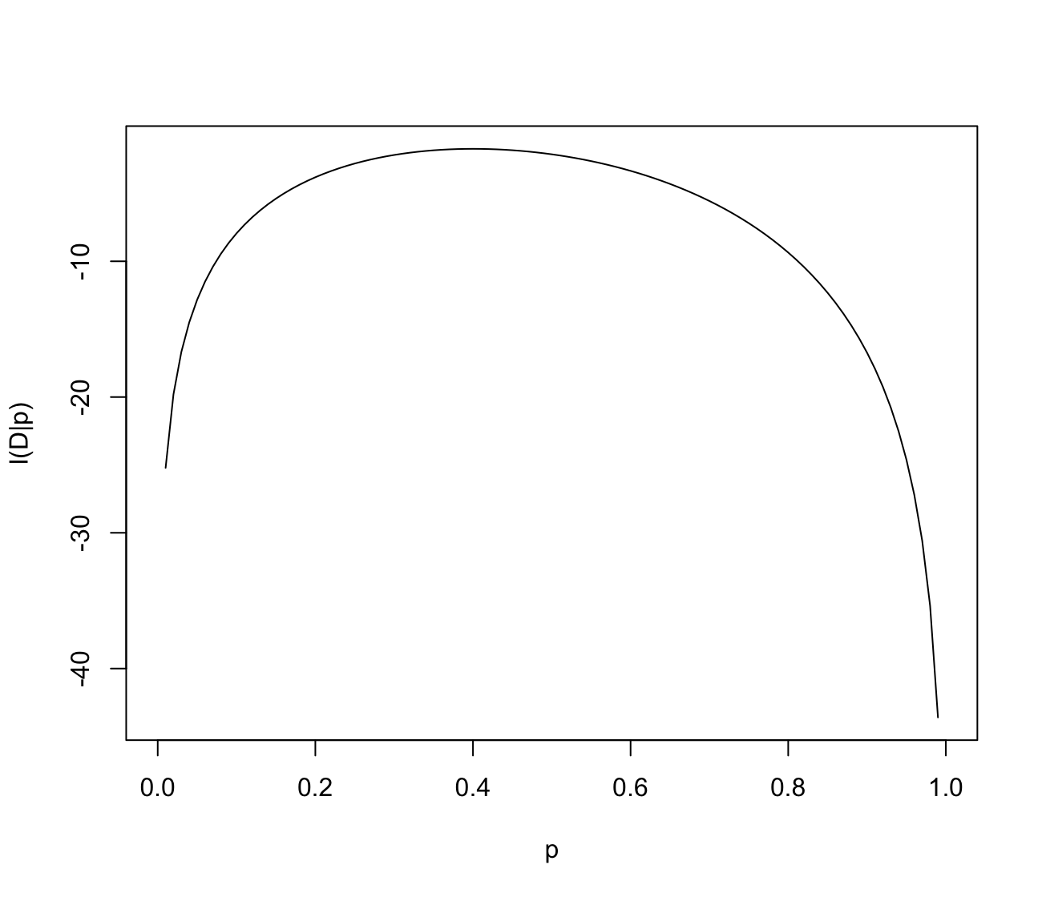
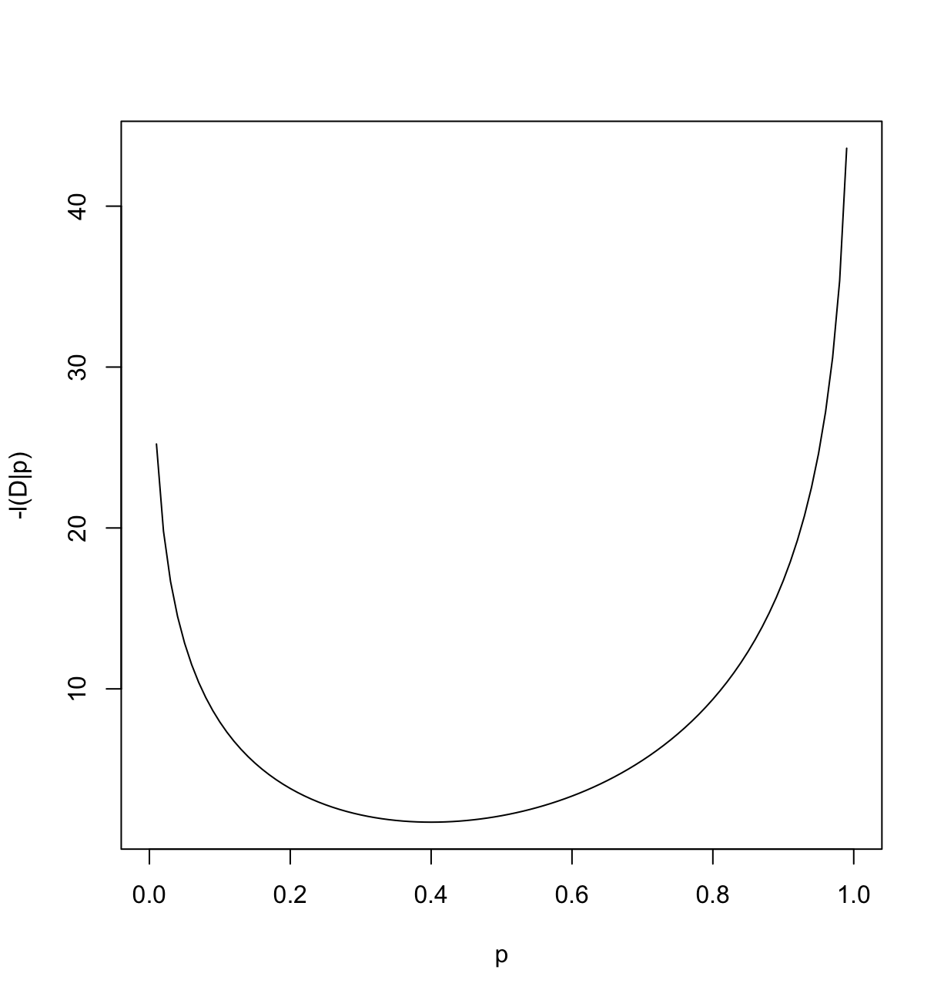
$$L\left(D | p\right)=\left(\begin{matrix}n \\ k\end{matrix}\right)p^{k}{\left(1−p\right)}^{n−k}$$

Slide 25

Analytical optimization
$$L\left(D | p\right)=\left(\begin{matrix}n \\ k\end{matrix}\right)p^{k}{\left(1−p\right)}^{n−k}$$
$$lnL=log\left(\begin{matrix}n \\ k\end{matrix}\right)∗k∗\log\left(p\right)∗\left(n−k\right)∗log(1−p)$$

Slide 26

Analytical optimization
$$L\left(D | p\right)=\left(\begin{matrix}n \\ k\end{matrix}\right)p^{k}{\left(1−p\right)}^{n−k}$$
$$lnL=log\left(\begin{matrix}n \\ k\end{matrix}\right)+k∗\log\left(p\right)+\left(n−k\right)∗log(1−p)$$

Slide 27

Analytical optimization
Solve for $\frac{dlnL}{dp}=0$

Slide 28

Analytical optimization
Solve for $\frac{dlnL}{dp}=0$
$$\frac{dlnL}{dp}=\frac{k}{p}−\frac{n−k}{1−p}$$

Slide 29

Analytical optimization
Solve for $\frac{dlogL}{dp}=0$
$$\frac{dlnL}{dp}=\frac{k}{p}−\frac{n−k}{1−p}$$
$$0=\frac{k}{p}−\frac{n−k}{1−p}$$

Slide 30

Analytical optimization
$$\frac{k}{p}=\frac{n−k}{1−p}$$
$$k∗\left(1−p\right)=p∗(n−k)$$
$$k−kp=pn−pk$$
$$k=pn$$
$$p=\frac{k}{n}$$

Slide 31
Analytical optimization
Some models are too complex and can not be solved analytically!

Slide 32
Minimizing functions
mle - minimize a real-valued function f subject to constraints (in library stats4).
optim – minimize a real-valued function f subject to constraints.
nlminb – minimize a constrained (or unconstrained) function.

Slide 33
Minimizing functions
curve(-dbinom(8, 20, x, TRUE), from = 0, to = 1, xlab = "p", ylab = "-l(D|p)")

Slide 34
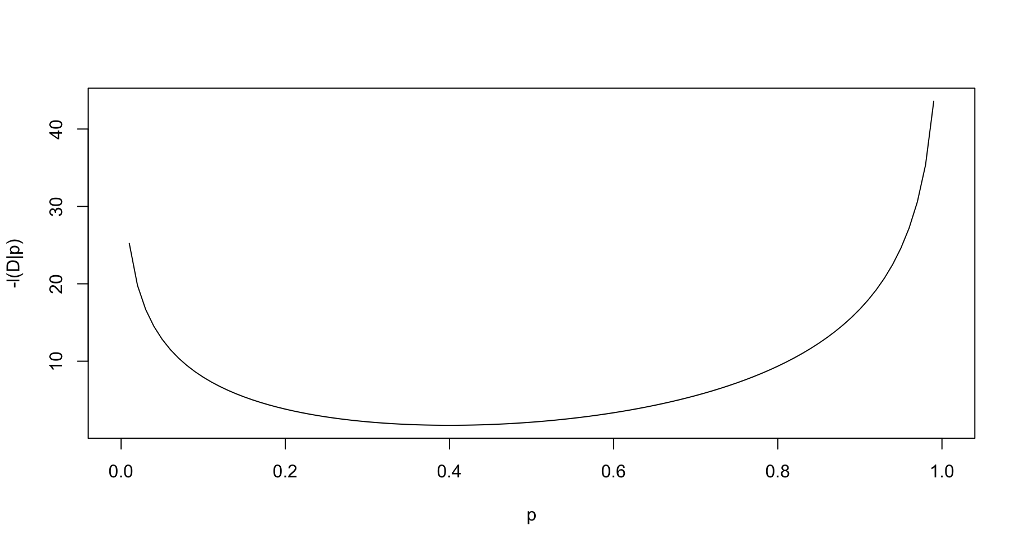
Optimización numérica
Las derivadas nos indican hacia que lado disminuye
Itera hacia el mínimo hasta que la derivada es 0
Esto se conoce como optimización numérica

Slide 35
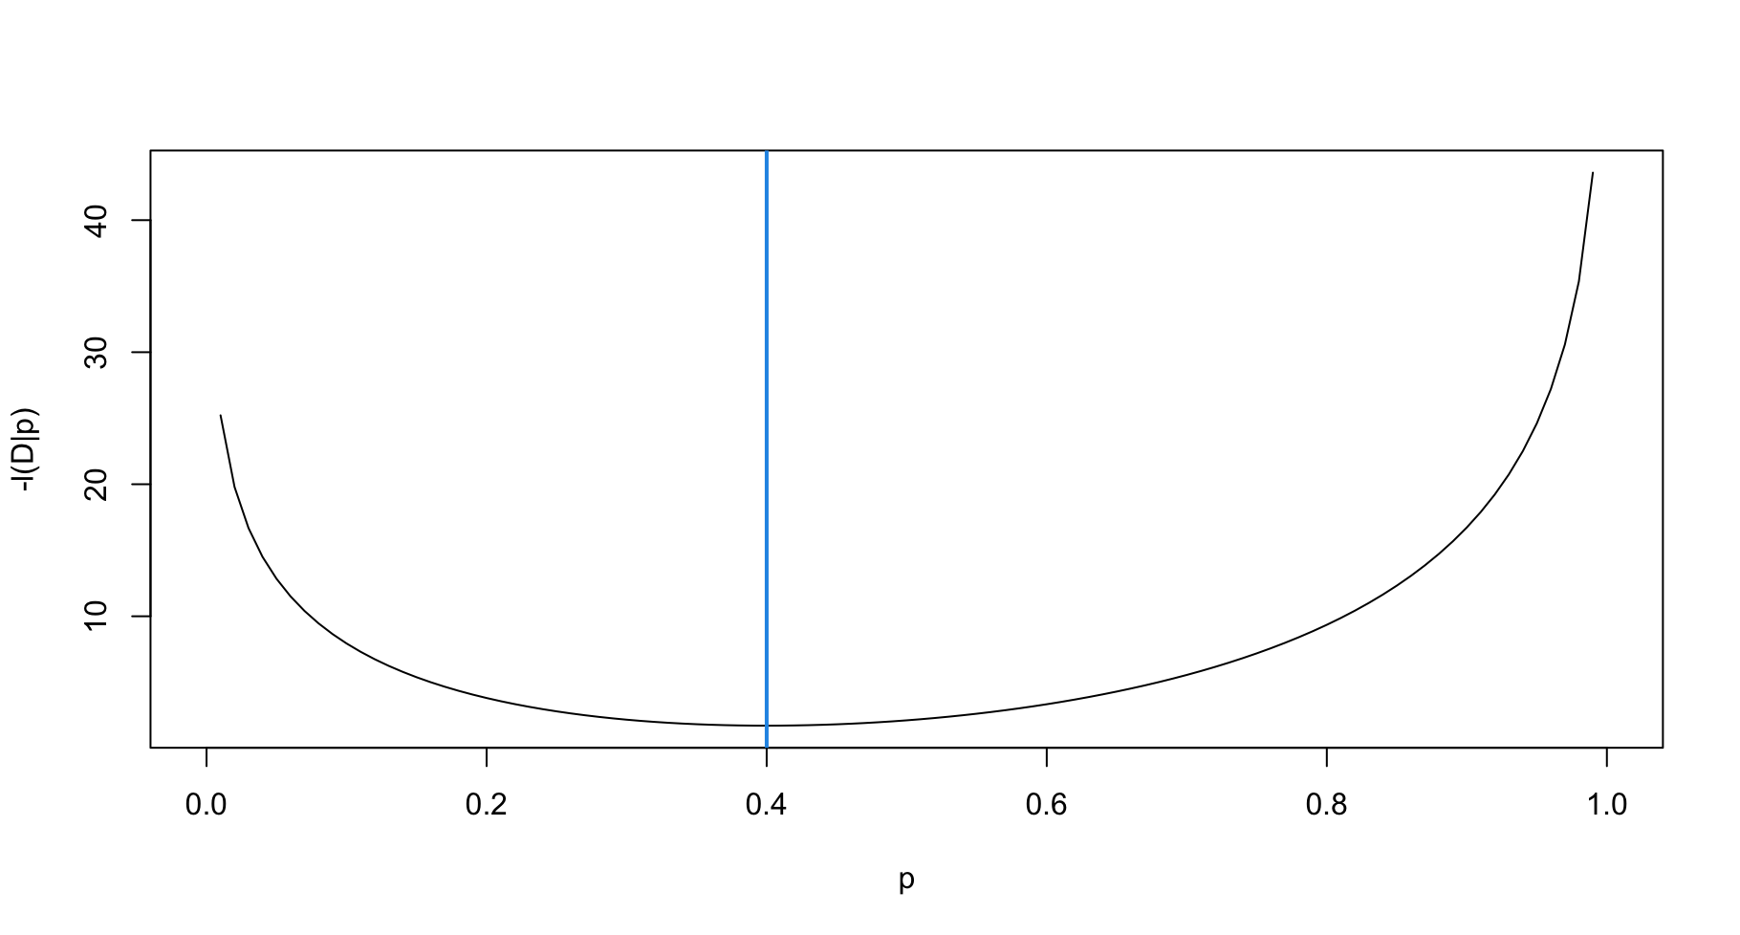
Optimización numérica
Las derivadas nos indican hacia que lado disminuye
Itera hacia el mínimo hasta que la derivada es 0
Esto se conoce como optimización numérica

Slide 36
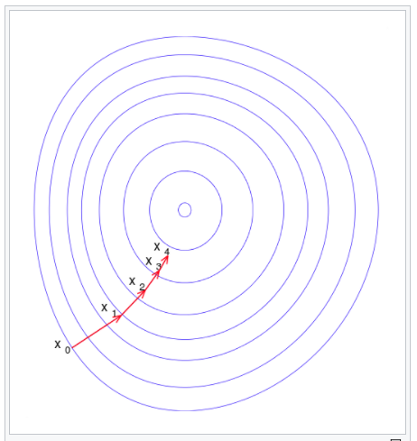
Minimización de una función (2D)
Los contornos muestas las cotas de nivel (como una vasija)
Pasos iterativos hacia el mínimo
Wikipedia.org

Slide 37
Calculando derivadas
Derivadas analíticas (i.e., una formula) son ideales, pero difíciles de obtener
Derivadas numéricas como las “diferencias finitas” (e.g., fija h=0.0001 en una formula) no son confiables
Entonces, cómo calculamos las gradients de funciones complejas (e.g., modelos estadísticos)?
Solución = “diferenciación automática”
Afortunadamente para nosotros el computador hace un truco mágico para calcular gradientes en forma rápida y exacta

Slide 38
Consultas?

